Slide 1

AI-BASED SMART GREENHOUSE AUTOMATION PLATFORM
KNOWLEDGE INSTITUTE OF TECHNOLOGY

Slide 2
AI-BASED SMART GREENHOUSE AUTOMATION PLATFORM
KNOWLEDGE INSTITUTE OF TECHNOLOGY
Smart IoT-Based Agriculture Monitoring, Automation & AI Suggestion System
Main Technologies:
ESP32
Blynk IoT
DHT22 Temperature & Humidity Sensor
Soil Moisture Sensor
Automatic Irrigation & Ventilation
Visual Studio Code
Python AI / Machine Learning

Slide 3
Double Content Slide OBJECTIVES
KNOWLEDGE INSTITUTE OF TECHNOLOGY
AI-Based Smart Greenhouse Automation Platform
An IoT-based system that monitors greenhouse environmental conditions and automatically controls the required devices for better crop growth.
The ESP32 collects temperature, humidity, soil moisture and light data.
The data is displayed locally and remotely through Blynk IoT, while Visual Studio Code with Python AI analyzes the readings and provides intelligent suggestions.
To develop a compact, low-cost and intelligent greenhouse automation system Monitor temperature and humidity.
Measure soil moisture.
Monitor light intensity.
Automatically control water pump and fan.
Provide remote monitoring using Blynk IoT.
Analyze sensor readings using Visual Studio Code + Python AI.
Provide AI-based suggestions for greenhouse management.

Slide 4
Bulleted List Slide
KNOWLEDGE INSTITUTE OF TECHNOLOGY
DHT22 – Measures temperature and humidity
Soil Moisture Sensor – Measures soil moisture
LDR / Light Sensor – Measures light intensity
ESP32 – Main controller and Wi-Fi communication
Relay Module – Controls greenhouse devices
Water Pump – Automatic irrigation
Exhaust Fan – Temperature and humidity control
LED Grow Light – Provides additional lighting
Blynk IoT – Remote monitoring
Visual Studio Code – AI application development
Python AI/ML – Sensor-data analysis and suggestions

Slide 5
Comparison Slide
KNOWLEDGE INSTITUTE OF TECHNOLOGY
Compare Section
Contrast Section
Traditional greenhouse systems mainly depend on manual monitoring and control of irrigation, temperature and lighting.
The proposed system uses ESP32 and sensors to continuously monitor greenhouse conditions and automatically control the required devices.
Unlike conventional greenhouse monitoring, this system integrates:
ESP32
Blynk IoT
Visual Studio Code
Python AI
Automatic control
The farmer can remotely monitor greenhouse conditions through Blynk, while the AI analyzes readings and provides suggestions.

Slide 6
Prototype
KNOWLEDGE INSTITUTE OF TECHNOLOGY
The prototype consists of an ESP32 connected to temperature, humidity, soil moisture and light sensors.
The ESP32 collects the sensor readings and controls the water pump, exhaust fan and grow light through relay modules.
The sensor data is sent through Wi-Fi to the Blynk IoT dashboard for remote monitoring.
The same readings are processed in Visual Studio Code using Python AI, which generates suggestions for greenhouse management.

Slide 7
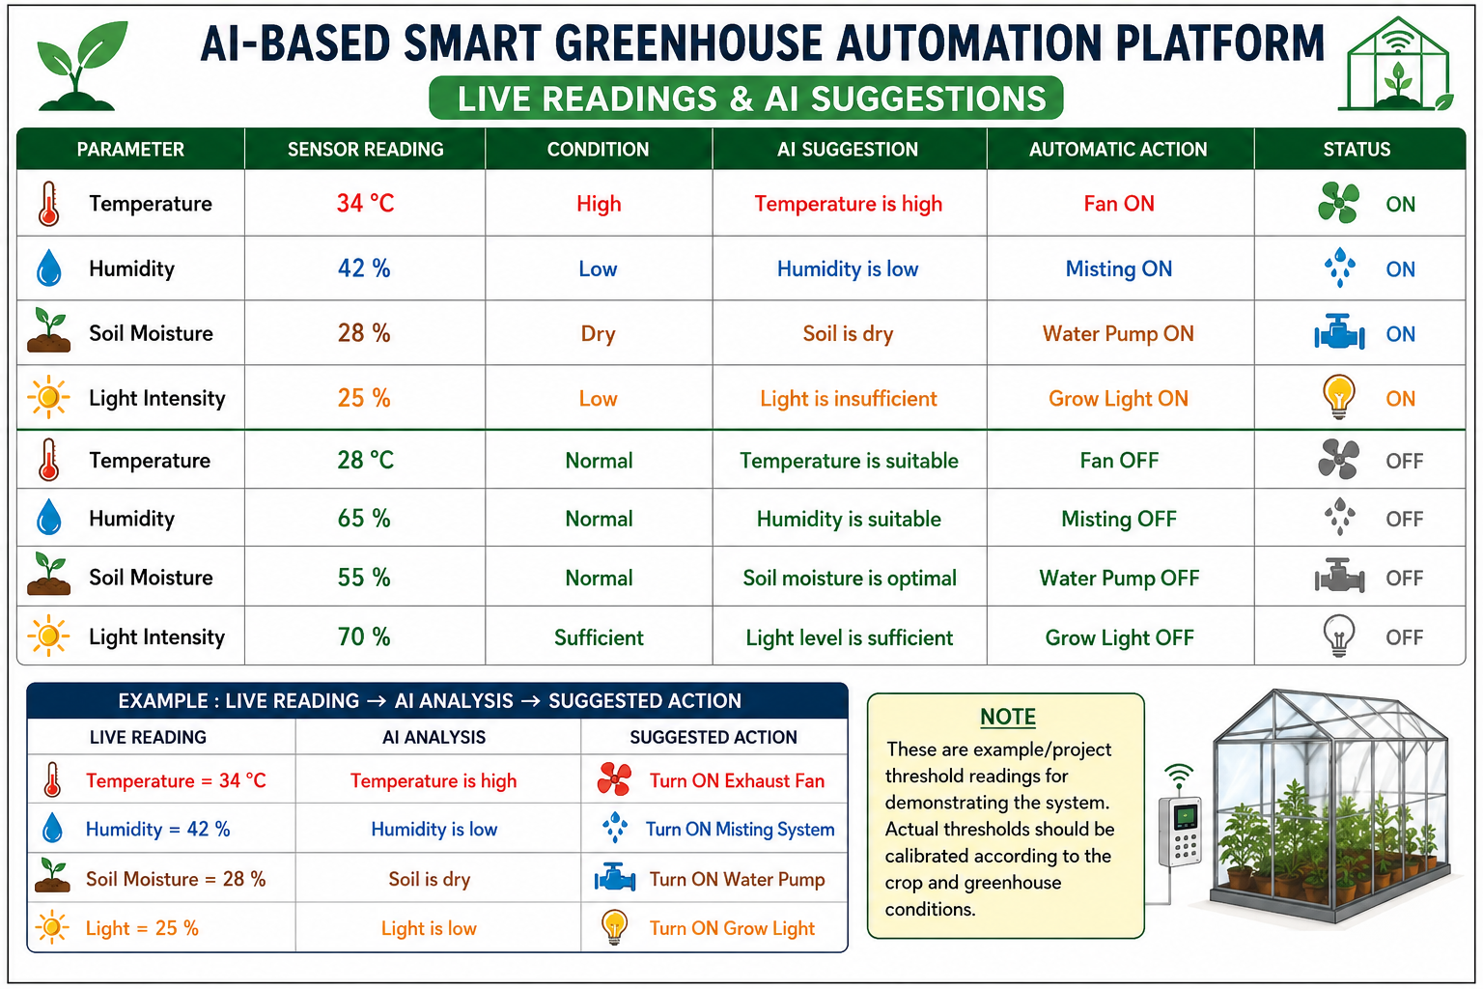
Detection Breakdown
KNOWLEDGE INSTITUTE OF TECHNOLOGY

Slide 8
CONCLUSION
KNOWLEDGE INSTITUTE OF TECHNOLOGY
The AI-Based Smart Greenhouse Automation Platform combines ESP32, sensors, automatic control, Blynk IoT and Visual Studio Code with Python AI.
The system provides real-time monitoring, remote access, automatic control and AI-based suggestions for efficient greenhouse management.
It provides a practical foundation for smart agriculture, reduced manual intervention and efficient resource utilization.

